Slide 1



R.N.S Institute of Technology
Department of ISE
DATA STRUCTURES
MINI PROJECT PRESENTATION
Carried out by,
SHREYA UDAY HASYAGAR(1RN18IS101)
SUPRIYA ALAVALA(1RN18IS110)
SINCHANA CHANDRASHEKAR (1RN18IS106)
2019-2020

Slide 2
CONTENTS
Abstract
Introduction
Data structures used
System Requirements
System Architecture
Implementation
Results
Conclusion & Future Enhancements
References

Slide 3
ABSTRACT
In computer science and mathematics, the Josephus problem (or Josephus permutation) is a theoretical problem related to a certain counting-out game.
The Josephus problem is a part of an algorithm analysis used to solve many problems related to circular operations. There is a simple mathematical algorithm designed to solve this problem, however the solution can be extended using more advanced techniques like recursive and non-recursive approaches to solve this problem. Here we are trying to find the most efficient way of solving the problem with the help of data structures.
In this project, we have solved the problem by designing a game using circular linked list to decide the survivor among the group of people.

Slide 4
INTRODUCTION
The problem is named after Flavius Josephus, a Jewish historian living in the 1st century. According to Josephus' account of the siege of Yodfat, he and his 40 soldiers were trapped in a cave by Roman soldiers. They chose suicide over capture, and settled on a serial method of committing suicide by drawing lots. Finally, he and another man remained until the end and surrendered to the Romans rather than killing themselves.

Slide 5
INTRODUCTION
JOSEPHUS PROBLEM:
There are n people standing in a circle waiting to be executed. The counting out begins at some point in the circle and proceeds around the circle in a fixed direction. In each step, a certain number of people are skipped and the next person is executed. The elimination proceeds around the circle (which is becoming smaller and smaller as the executed people are removed), until only the last person remains, who is given freedom. Given the total number of persons n and a number m which indicates that m-1 persons are skipped and m-th person is killed in circle. The task is to choose the place in the initial circle so that you are the last one remaining and so survive.

Slide 6
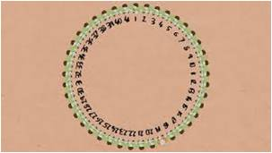

INTRODUCTION
The process of execution of people in a circle:
The above picture shows soldiers standing in a circle, who are to be executed.
.

Slide 7
INTRODUCTION
EXAMPLE:
If, n = 5 and m = 2,
Firstly, the person at position 2 is killed, then person at position 4 is killed, then person at position 1 is killed.
Finally, the person at position 5 is killed. So the person at position 3 survives.

Slide 8
DATA STRUCTURES USED
METHOD -1:
CIRCULAR LINKED LIST
LINKED LIST: A linked list is a non-sequential collection of data items. A dynamic data structure. For every data item in linked list a NODE is created, which has two fields- data field and link field. Data field holds the data where as the link field has a associated pointer that holds the address /memory location of the next node in the list.
TYPES OF LINKED LIST:
Singly Linked List.
Doubly Linked List.
Circular Linked List.
Doubly Circular Linked List.
CIRCULAR LINKED LIST:
This is a type of linked list in which the last node of the list is connected to first node of the list. This is done by storing the address of the first node in the last node’s link field.

Slide 9
DATA STRUCTURES USED
METHOD -2:
RECURSION:
Recursion is a process in which a function calls itself multiple times . The function that calls itself is called a recursive function.
The problem has following recursive structure,
Josephus(n, k) = (Josephus(n - 1, k) + k-1) % n + 1
Josephus(1, k) = 1
After the first person (kth from beginning) is killed, n-1 persons are left. So we call Josephus(n – 1, k) to get the position with (n-1) persons. But the position returned by Josephus(n – 1, k) will consider the position starting from k%n + 1. So, we must make adjustments to the position returned by Josephus(n – 1, k).

Slide 10
SYSTEM REQUIREMENTS
HARDWARE REQUIREMENTS
SOFTWARE REQUIREMENTS
Processor :INTEL CORE i3
Speed : 2.33 GHz
RAM : 2 GB(min)
Hard Disk : 20 GB
OS : Windows 10
IDE : NetBeans 7.1
Compiler : Turbo C
(any C editor)

Slide 11
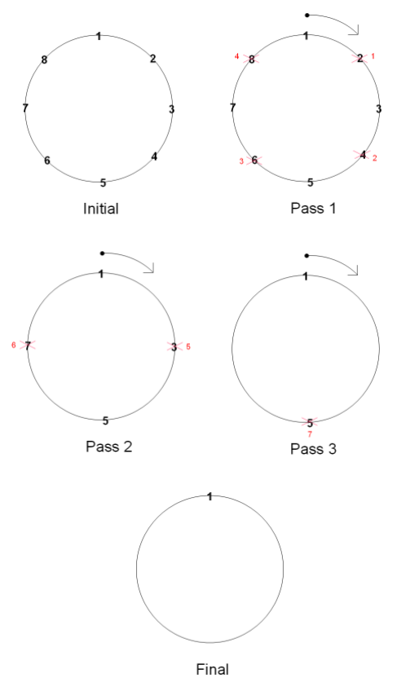
SYSTEM ARCHITECTURE
The beside shows a diagrammatic scheme of the Josephus circle where n=8 and k=2, i.e. every second person is executed.

Slide 12
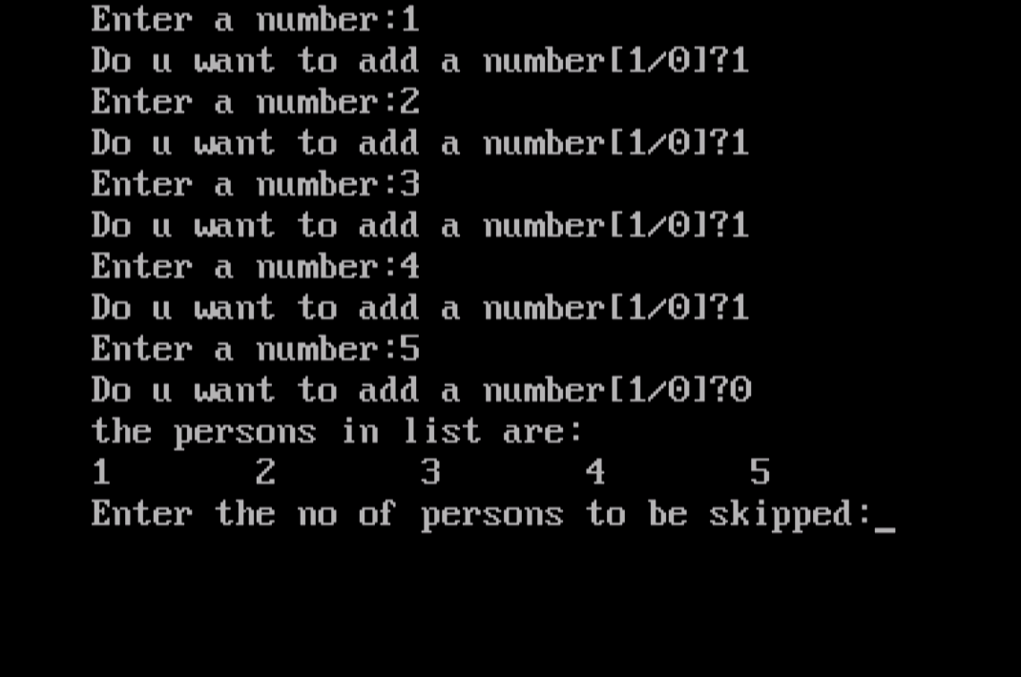
SYSTEM ARCHITECTURE

Slide 13
IMPLEMENTATION
A node is created with num as data field and next as link field, main() calls three functions namely create(), display(),survivor(). Initially head is globally declared and points to the node and is made null.
DISPLAY:
Temp is created and assigned to head. Temp is used to traverse each node and display the data.
The first element is printed and the temp is made to point the next node and then the while loop gets executed until (temp!=head) i.e. when temp->next=head meaning all the nodes are traversed and it has come back to the first node again, as it is circular linked list.

Slide 14
void display()
{ struct node *temp; temp = head; printf("%d ", temp->num); temp = temp->next; while (temp!=head)
{ printf("%d ", temp->num); temp = temp->next;
} printf("\n");
}

Slide 15
CREATE:
Two members are declared-temp and rear. Temp is used to create a new node each time a person needs to be added to the circle whereas, rear is used to keep track of where the temp needs to be attached.
The do-while keeps looping until the user is done adding the nodes(i.e. ch !=0). Each time we need to add a node(temp) a malloc function is used to allocate memory and the inputted data from the user is added to the data field.
According to whether the head is NULL(i.e. empty list) or not ,the link field is updated and added to the list using the if-else loop.
Each time a node is added it is added to the right of the node.
Rear=temp, would update the rear after each addition.
The rear points to the last node present, hence its link field is pointed to the first node i.e. head since it is a circular linked list (rear->next=*head).

Slide 16
if (head == NULL)
{
head = temp;
}
else
{
rear->next = temp;
}
rear = temp;
printf("Do you want to add a number [1/0]? ");
scanf("%d", &ch);
} while (ch != 0);
rear->next = *head;
}
void create ()
{
struct node *temp,*rear;
int a , ch;
do
{
printf(“enter a number:”);
scanf(“%d”, &a);
temp=(struct node *) malloc(sizeof(struct node));
temp->num = a;
temp->next = NULL;

Slide 17
SURVIVOR:
The function accepts the no of people to be skipped.
There are two members-p , q. P is used to point to the kth node and free it each time and q is used to keep track of the position where p needs to return back to continue the process again.
The while loop will keep executing until the node pointed by p is the only node remaining.(p->next=p).
There are different steps/stages in which the problem is solved:
The (k-1) people have to be skipped before the execution of the k th person. Hence a for loop is used to skip (k-1) nodes( people) in the circle.
The kth person is eliminated by linking the node pointed by the q to the right node of the eliminated node(p). And then freeing the node.
The process of the step 1 and 2 need to be started again where it previously stopped which is pointed by q. Hence p is updated to q until p is the only node left in the circle and that is that survivor.

Slide 18
int survivor( int k)
{ struct node *p,*q; int i; q = p = head; while (p->next != p)
{ for (i = 0; i < k - 1; i++)
{ q = p; p = p->next;
} q->next = p->next; printf("%d has been killed.\n", p->num); free(p); p = q->next;
} head = p; return (p->num);
}

Slide 19
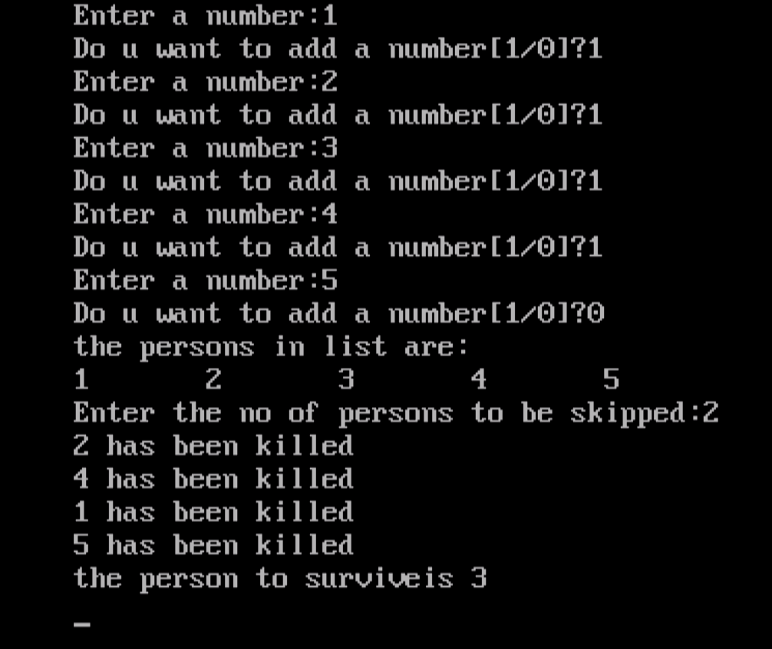
RESULTS

Slide 20
CONCLUSION
& FUTURE ENHANCEMENT
CONCLUSION:
The Josephus problem helps us to quickly compute the correct place to stand in a circle to win a game.
ENHANCEMENTS:
As the history mentions, Josephus wanted to find the right spot to be saved.
It is considered that, the soldiers started killing the person beside them starting from a point(that is k=2). HENCE IT WAS ONLY CONFINED TO K=2.
These functions and code can be advanced in many ways those are,
The number of people to be skipped (WHICH IS ENHANCED).
The direction in which we want to execute people.(CLOCKWISE or ANTICLOCKWISE).

Slide 21
CONCLUSION
& FUTURE ENHANCEMENT
The starting point from where the execution may start.(DEFAULT: taken as a 1st node or person 1).
APPLICATIONS:
This circular approach of the Josephus problem can also
be implemented to design applications in the domain of Game Theory.
FINALLY,
As there are multiple ways of executing this problem. It is advised to consider the time complexity and space complexity hence implement it.

Slide 22
REFERENCES
Ellis Horowitz and Sartaj Sahni, Fundamentals of Data Structures in C, Universities Press, 2014.
Seymour Lipschutz, Data Structures Schaum's Outlines, Revised 1st Ed, McGraw Hill, 2014.
Chapter 8, part 7 of Josephus' The Jewish War.
Josephus problem-Wikipedia.
Geeksforgeeks.

Slide 23
Thank you

